Slide 1
Christ Evangelical
Lutheran
Church
Avon Lake, Ohio

Slide 2
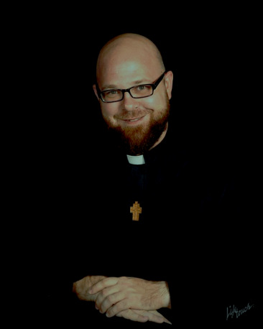
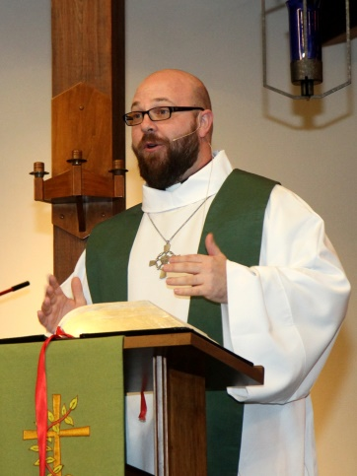
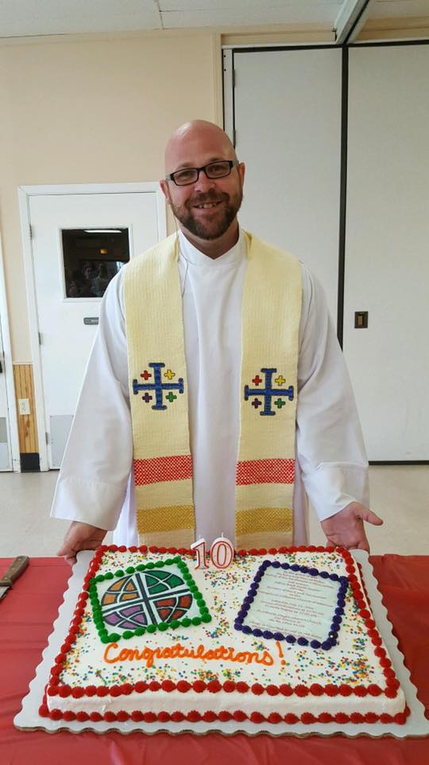
Our Pastor
Jeff Steeber

Slide 3
Worship
Saturday worship at 5:00 p.m.
Sunday worship at 10:30 a.m.

Slide 4
We are happy to have you with us and wish you a warm welcome. If you would like more information about our church and its ministries, please look for a member for the Welcoming Team by the TV after the service for information and a gift.

Slide 5
Prayer Request
Please pray for Phyllis Rehker and her family. Update - She has been transferred to Towne Center in Avon Lake.

Slide 6
Today’s Flowers
Today’s flowers are given by
the Nordman family
in celebration of family and friends near and far.
Notes:
Image: Ruins, Jerusalem Archaeological Park, Israel. Copyright © Hanan Isachar/Superstock. Used by permission.

Slide 7
Congregation News
We are looking for a few volunteers to help keep entrances clear when the snow falls. Please touch base with Brian Knip for information if you are able to help out on our new snow removal team this winter.

Slide 8
Congregation News
Taking down the greens will take place right after the service on Sunday, January 8. We are looking for more hands to make the job faster and lighter. Please stay after church and offer some help.

Slide 9
Congregation News
Sunday school will resume on Sunday, January 8. We hope to see you there!

Slide 10
Congregation News
The 3rd Grade Bible Class will be meeting on Sundays, January 15, 22, and 29 from 9:30 to 10:15 a.m. in the Social Hall.

Slide 11
Fellowship Opportunities
Bring your own coffee hour will follow the services on Saturday, January 7 and Sunday, January 8. Please see Sue Jagoda or Bill Higgins with any questions.
Bratwurst and Brews at 5:00 p.m. on January 28 at Sue Jagodas. A signup sheet is in the hallway, please share what you plan to bring.

Slide 12
This week at CELC
Sunday, January 8
9:30 a.m. Sunday school
10:30 a.m. Worship
11:30 a.m. BYO coffee hour
11:30 a.m. Taking down the greens
11:45 a.m. Praise band practice
Tuesday, January 10
9:30 a.m. Pastor chat with preschoolers
12:00 p.m. Lydia/Naomi Circle
12:45 p.m. Pastor chat with preschoolers
7:00 p.m. Anna Circle

Slide 13
This week at CELC
Wednesday, January 11
10:30 a.m. Adult Bible study
6:30 p.m. Bell choir
7:30 p.m. Choir
Friday, January 12
Pastor’s day off

Slide 14
This week at CELC
Saturday, January 14
6:30 a.m. Men’s Bible study
3:30 p.m. Praise Band practice
5:00 p.m. Worship
Sunday, January 15
9:30 a.m. Sunday school
9:30 a.m. 3rd grade Bible class
10:30 a.m. Worship

Slide 15
This week at CELC continued
CELC Preschool
Good Kids Day Care
Monday- Thursday
9:30 a.m. – 11: 30 a.m. CELC Preschool
12:30 p.m. – 3:00 p.m. CELC Preschool
Friday
9:00 a.m. – 11:30 a.m. CELC Preschool
Monday- Friday
6:30 a.m. – 6:00 p.m. Good Kids Childcare

Slide 16
Attention families
Located just outside of the Sanctuary doors you will find activity bags and clip boards for kid’s to explore and use. Please feel free to take one to your seat with you and return it back to the same location when you are finished. Thank you

Slide 17
Worship assistants and volunteers
This Sunday Next Sunday
Greeters:
Usher:
Lector:
Acolytes:
Cantor:
Assists:
Altar:
Counter:
Bread:
Rockas Family
Chip Crout
Amy Klenz
Kelly Owens
Isabella Higley
Jamie Crout
Cantor
Anita Hlava
Karen Wagner
Acolytes
Marilyn Culler
Chuck Heindrichs
Jean Crawford
Doris Klement
Brian Knip
Laura Musat
Sarah Skaggs
Angela Pedersen
Joe Guthman
Cantor
Doris Klement
Laura Musat
Acolytes
Marilyn Culler
The Trio
Jamie Crout

Slide 18
